Slide 1
Parallel Poisson 2D Solver
Dewi Yokelson and Cameron Durbin
December 8, 2020

Slide 2
Project Summary
Solve a 2D Poisson problem
Parallelize with CUDA
Experiments
Results
Notes:
Dewi

Slide 3
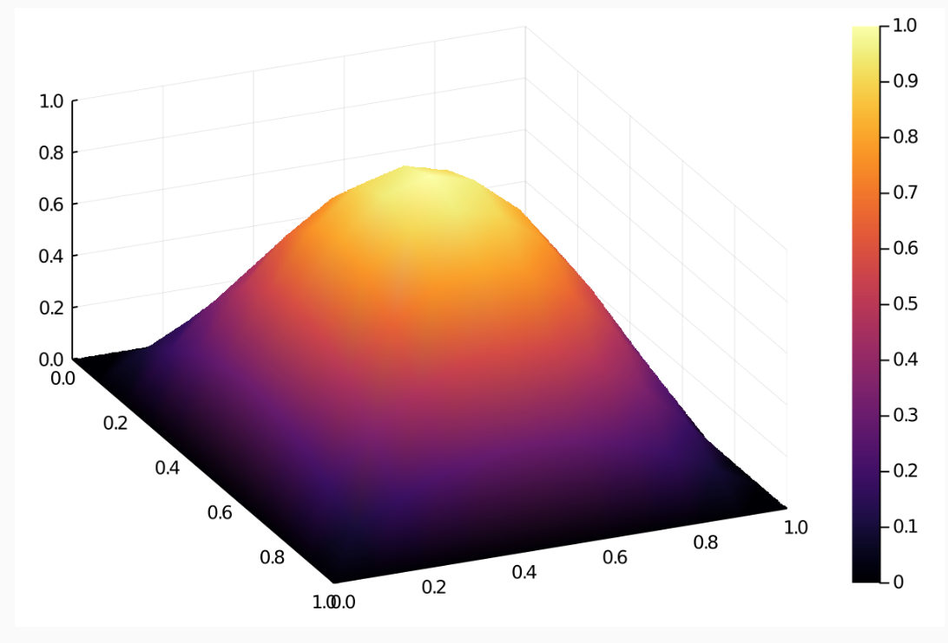
Poisson Problem setup
Steady State Heat Equation
Uniform Square Plate
Boundaries all held at 0
The “source term” F(x,y) represents heat being applied
K[U_{xx} + U_{yy}] + F(x,y) = 0
F(x,y) = 2kπ²(sin(πx)sin(πy))
Exact Solution U_{e} = sin(πx)sin(πy)
Notes:
Dewi

Slide 4
Conjugate Gradient Approach
Discretize in space
Form Ax + b
Initial random guess x
Data setup in Julia
Code in C++/CUDA/CUBLAS
https://people.eecs.berkeley.edu/~demmel/cs267/lecture24/lecture24.html
Notes:
Dewi

Slide 5
CUDA Implementation
Conjugate Gradient method calls parallelized matrix/vector functions
CUBLAS Library for most kernels (dot product, gemv)
Thread/blocks set automatically
Custom vector add kernel
Notes:
Cameron

Slide 6
experiments
Convergence tests
Increase matrix dimensions
Compare dense and sparse (CSR) matrices
Notes:
Cameron

Slide 7
Results – Convergence test
Δx, Δy | Error | Error Ratio | Error Rate | Iterations
0.1 | 0.004132708 | N/A | N/A | 12
0.05 | 0.001029353 | 4.0148588 | 2.00534925 | 37
0.025 | 0.0002571 | 4.00370452 | 2.0013355 | 81
Notes:
Dewi

Slide 8
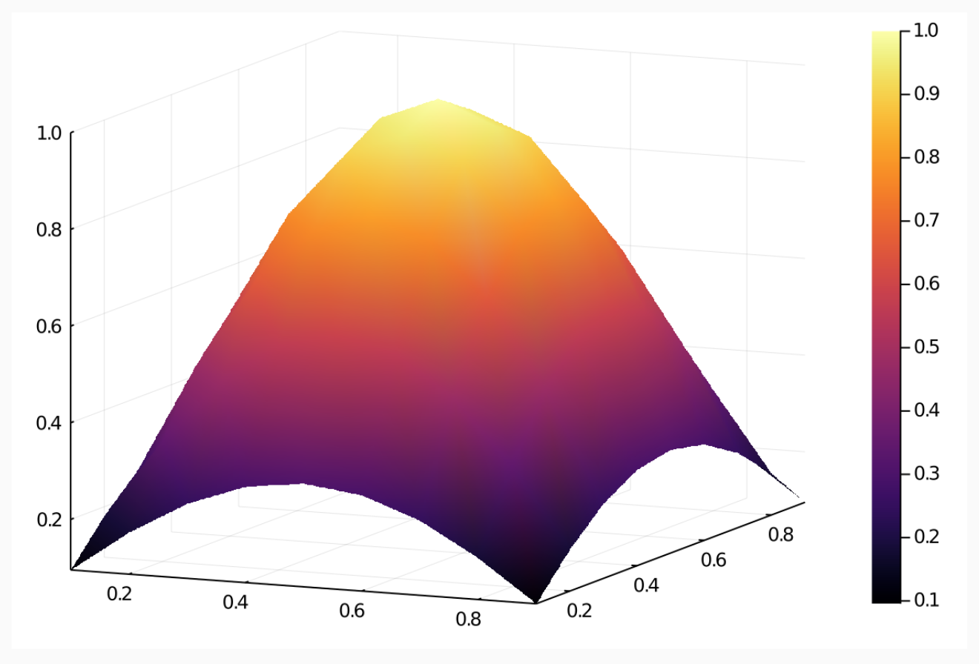
RESULTS: Δx, ΔY = 0.1
Exact
Approximate
Notes:
Dewi

Slide 9
Results
Notes:
Cameron

Slide 10
Challenges
Matrix file I/O in between Julia and C++ files
Dense matrices got slow…quickly
Unable to change thread/block count
Notes:
Cameron

Slide 11
Future Work
Custom kernels to experiment with different thread/block sizes
Compare with serial implementation
Compare with other types of sparse matrices
Create even larger input data sets
Notes:
Dewi

Slide 12
Questions?

